Slide 1
Synoptic Project Methodolgy

Slide 2
Context up to 35%

Slide 3
Overview
Title
Aim / Objectives, Research Questions, rationale
Literature Review
Methods
Data Presentation (examples)
Analysis / Discussion
Conclusion
Reflection

Slide 4
KISS

Slide 5
Ask yourself 5 Ws
Who?
What is planned
When is it to take place?
Where will it take place?
Why are you doing it this way?

Slide 6
How will you do it!

Slide 7
Methodology
The four types of method that should be covered are:
Literature review methods
Domain-specific methods
Evaluation methods
Project management methods

Slide 8
Literature review methods
which databases or repositories you used (e.g. Google Scholar, ACM, IEEE, etc)
which search keywords and filters you used
the total number of references that were found
how you filtered the total number down and how you selected the references that you eventually used

Slide 9
Domain Specific Methods
Optional methods
Methods selected – justification
Method detail – experiment / questionnaire etc
Method execution – inc R&D, trialling, test bed etc
Data Collection / Data Handling

Slide 10
Quality Issues

Slide 11
Reliability?

Slide 12
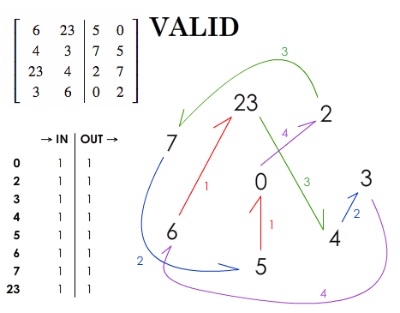
Validity

Slide 13
Error,

Slide 14
Bias

Slide 15
Ethics

Slide 16
Evaluation Method(s)

Slide 17
Evaluation
How are you going to make sense of what you have found out?
Three scenarios
1. Method pre-existing/ well known meets all QA criteria – cite it and use it
2. Method developed from and clearly linked to ID theories and models for literature Review – cite it use and reflect
3. Novel method – use and justify and reflect on results

Slide 18
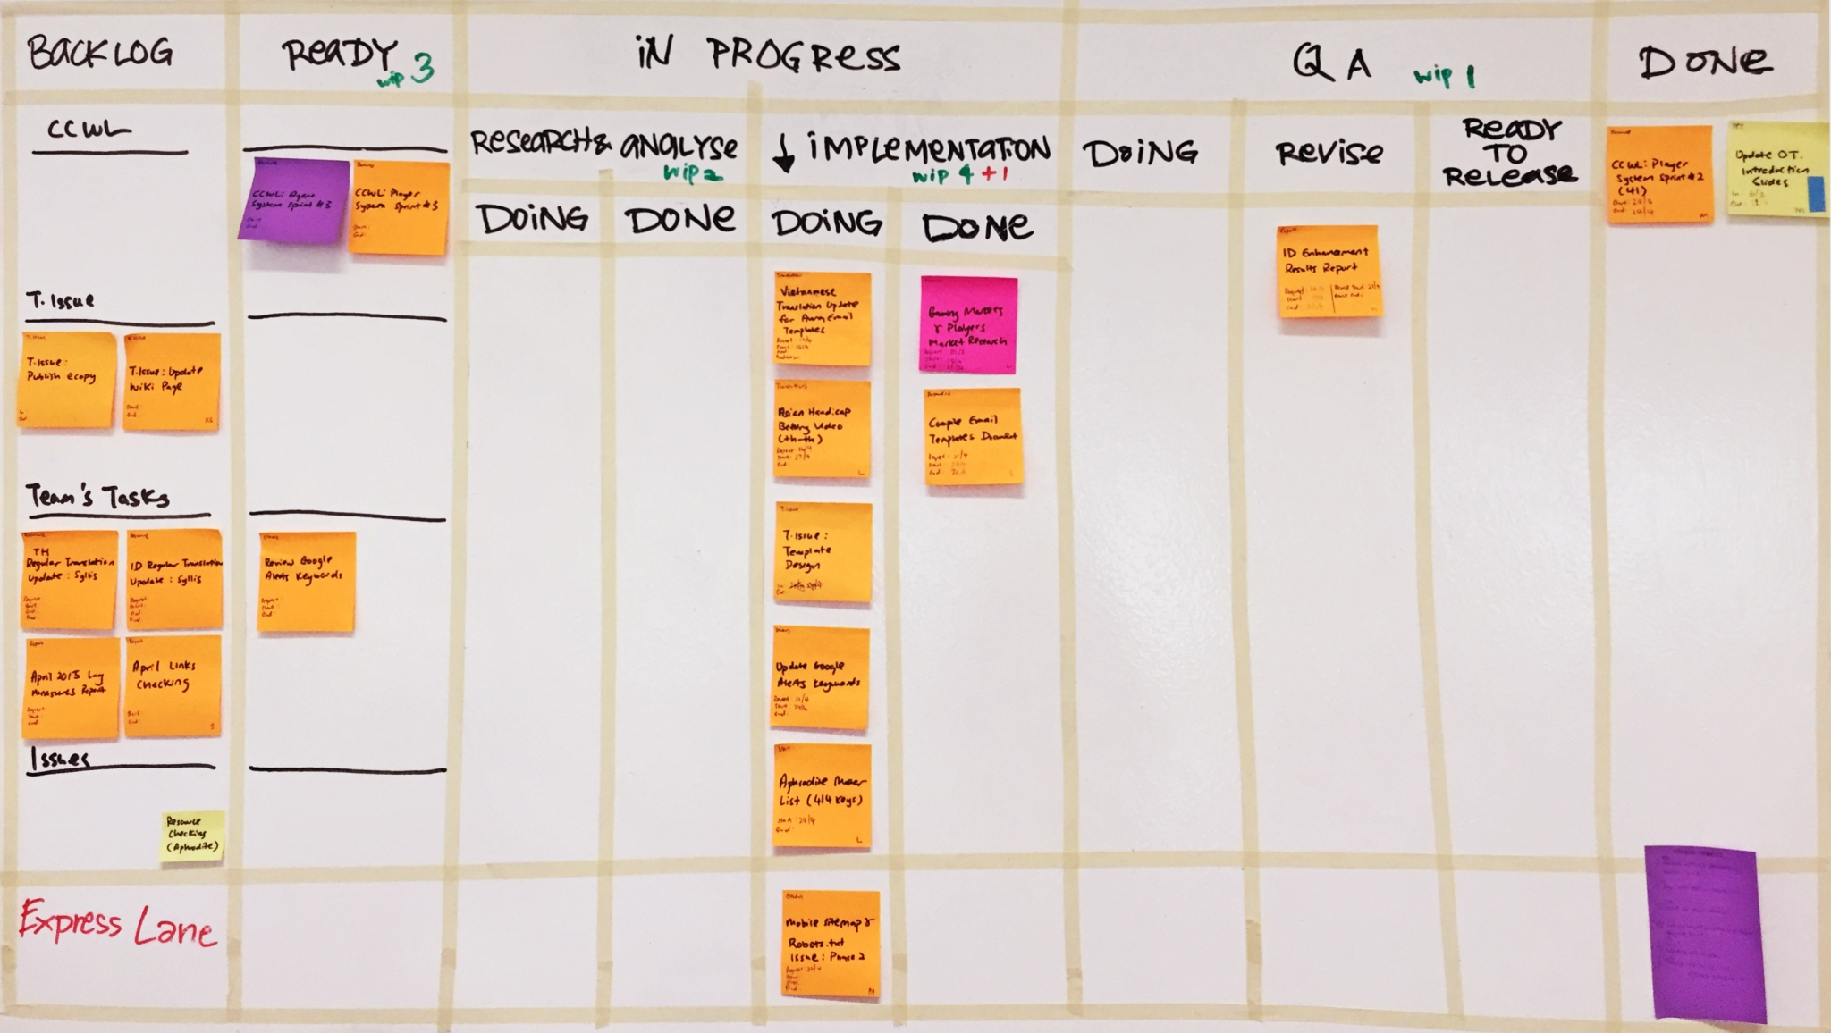
Project Management Methodology
This Photo by Unknown Author is licensed under CC BY-SA-NC

Slide 19
Options
Agile –
MoScoW
Kanban
Scrum
Waterfall
Lean Start Up
Gannt

Slide 20
“Possible Chapter Outline”
Introduction
Optional methods
Methods selected – justification
Method detail – experiment / questionnaire etc
Method execution
Data Collection
Data analysis method
Summary Review
Limitations: Error, Bias, Ethics

Slide 21
Summary
Methodology – a collection of methods – you need 4 in your chapter
Methodology are “Plans of Action” of how you are to execute methods to achieve aim
Use past tense for Lit Review
Use preset for project management
Use future tense for domain specific methodology / evaluation method
Main body of text for “high level” detail and plans
Appendices for process detail
Remember, level of detail necessary so that the markers could repeat

