Slide 1
SOC10701 2024-5 Synoptic Project Line Manager Brief
John Colvin
August 2024

Slide 2
Objectives
Context: 2024_5 programme overview
What is the synoptic project and what it is not?
What makes a good SP topic area, what is not!
What can you do to help?
Timescales
Q&A

Slide 3
Learning Outcomes
Summarise significant theoretical concepts with reference to current academic and professional literature
Demonstrate a critical understanding of the management of substantial real-world activity including planning, documentation and control
Demonstrate professional competence in the application of the core and specialist knowledge and skills to meet the outcomes of an Honours-level Apprentice.

Slide 4
Learning Outcomes
Show a capacity for reflective analysis by analysing the strengths and weaknesses of the processes and outcomes of the activity undertaken with reference to their defined objectives and to the work of others, and by evaluating your own skills and personal development
Provide evidence of the foregoing in the form of a report which conforms to appropriate standards of presentation and format

Slide 5
SP is
Executed by a Single active researcher
Completed in limited time – August 2023 – April 2024
Default: has access to limited physical resources
Default: Has limited/no budget
Has Sept – Nov 23 competing academic and workplace pressures

Slide 6
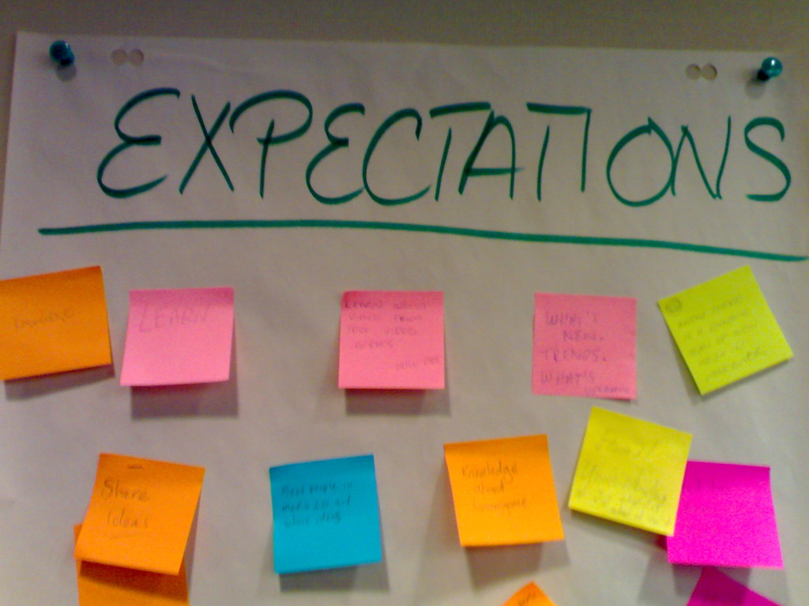
SP Expectations
Expectation of outputs of the work is at undergraduate level and does not necessarily reflect the level of how KSBs or underpinning models and theories are exercised in your teams – Level 6 / 10
Publishable outputs or significant new knowledge / findings are NOT expected

Slide 7
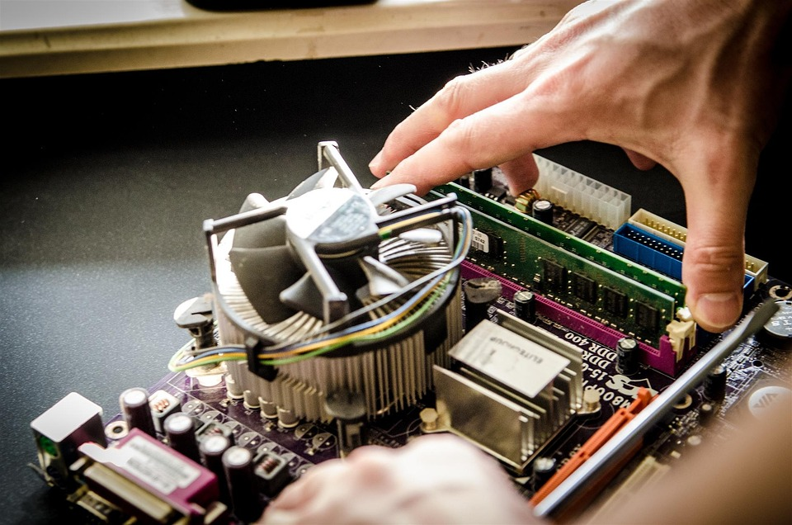
SP IS
To self-manage an extended project – INDIVIDUAL!
To investigate a work-related project in depth @ OFFICIAL
To detail process and write up in a rigorous academic manner
To map work and writing to stated formats and assessment criteria – level 6 / 10

Slide 8
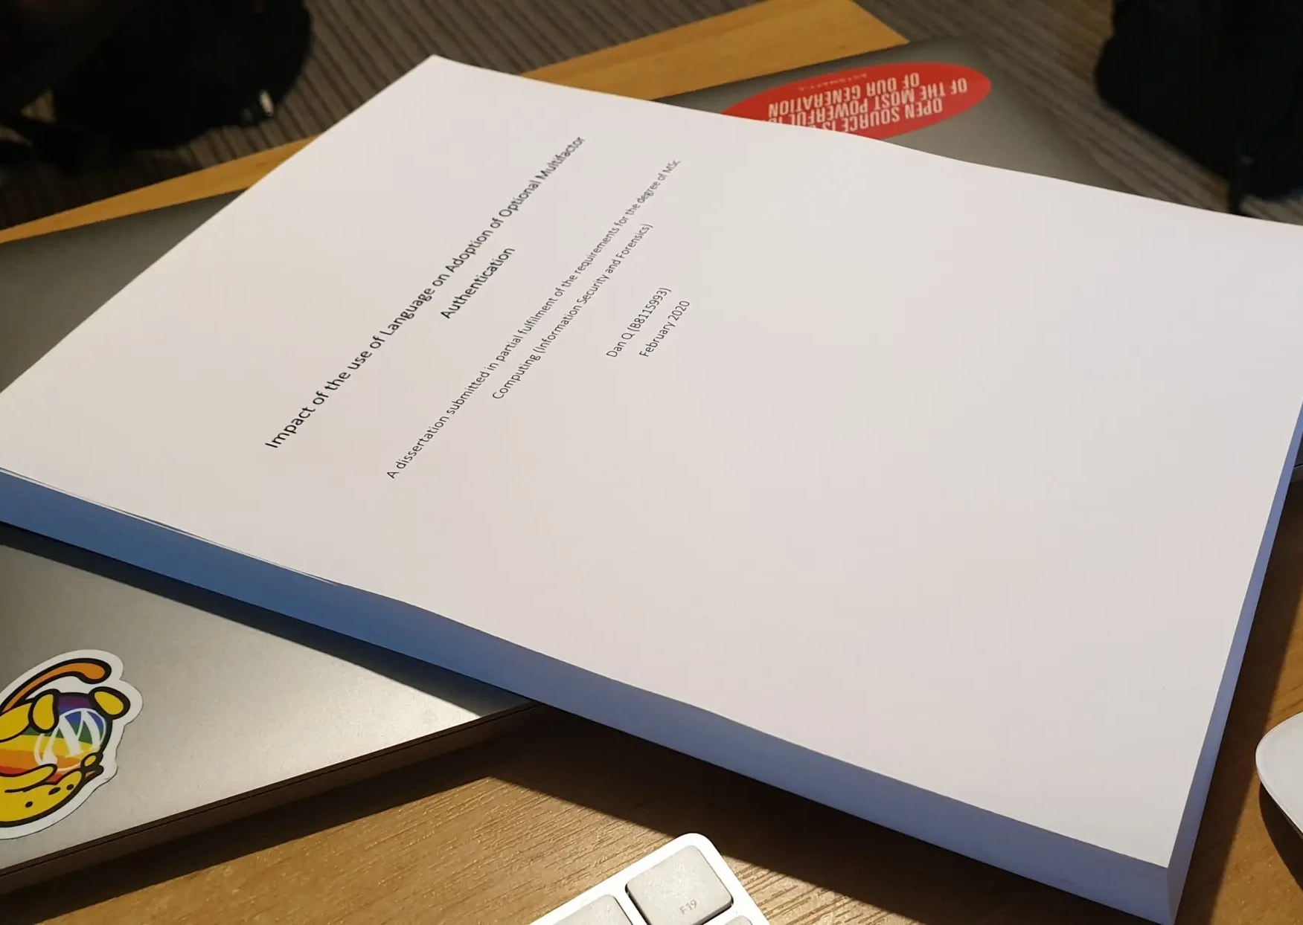
SP is NOT
An academic treatise / dissertation
A workplace project with solely internal outcomes
A research project with aims to publish findings
A secondary descriptive narrative

Slide 9
What makes a good topic?

Slide 10
A good topic?
A topic integral to your team core or secondary duties
Onboarding project – adds to team knowledge base
Appropriate scope, scale / focus – 6 / 10 - to meet SP task brief and assessment criteria
Timescales: September 24 _ April 25

Slide 11
A good topic?
A topic where there is an existing canon of literature available to review – KEY POINT
A topic where it is easy to show collection / analysis of data
One where YOU are interested☺

Slide 12
A good topic?
Cyber is a broad church – AI to IA and all in- between
Focus and depth
IT is up to the apprentice to choose – they have a list of past projects
IT is up to us – ALL STAKEHOLDERS - to make it work

Slide 13
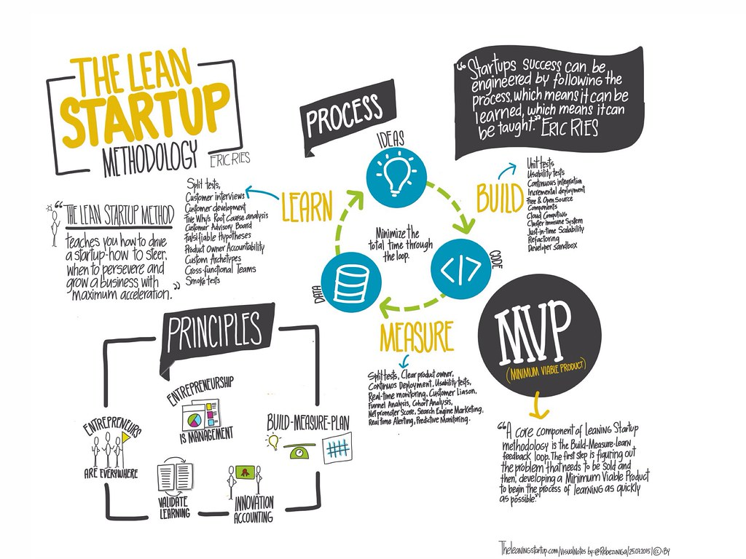
SP Process September

Slide 14
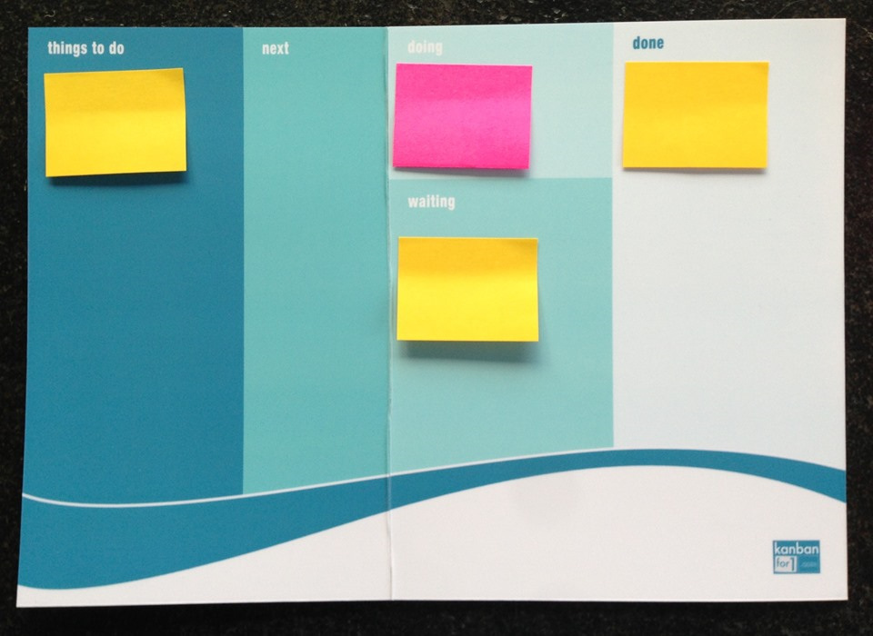
Time line 1
29/31. 08.23 : Line Manager Briefings
30 .08.23 : Proposal Development Workshop
04 – 15.089.23 : Apprentices develop draft proposal and agree with LM.
18- 21.09.23 : SP Week 1:
Agree Topics
29.09.23 : Proposal Submission

Slide 15
Time line 2
Proposal Workshop 30.08.23
Proposal 29.09.23
Literature Review: 11.10.23
Poster Show: 01.11.23
Methods: 02.11.23
Foundation Document 12.01.24
Results: 07.02.24
Conclusion: 06.03.24
Final Submission 12.04.24

Slide 16
Assessment (briefly)

Slide 17
Report Structure: 8 - 10,000 words
Abstract
Aims and Objectives
Literature Review
Methodology
Results
Discussion / Analysis
Conclusion
References etc

Slide 18
Assessed By A Clear Set Of Criteria
 | Weighting
Project aim | 10%
Use of academic sources (or sources of equivalent quality) - range of sources, criticality, focus | 25%
Description of methods (including project management | 10%
Application of methods | 25%
Conclusions and reflective analysis | 20%
Language and presentation | 10%

Slide 19
Final Marking Schedule
55% Desk and Process Driven
45% application and reflection

Slide 20
It’s the project, not the results!
Not all projects go to plan
Not all projects work
Not all projects are successful
Not a problem

Slide 21
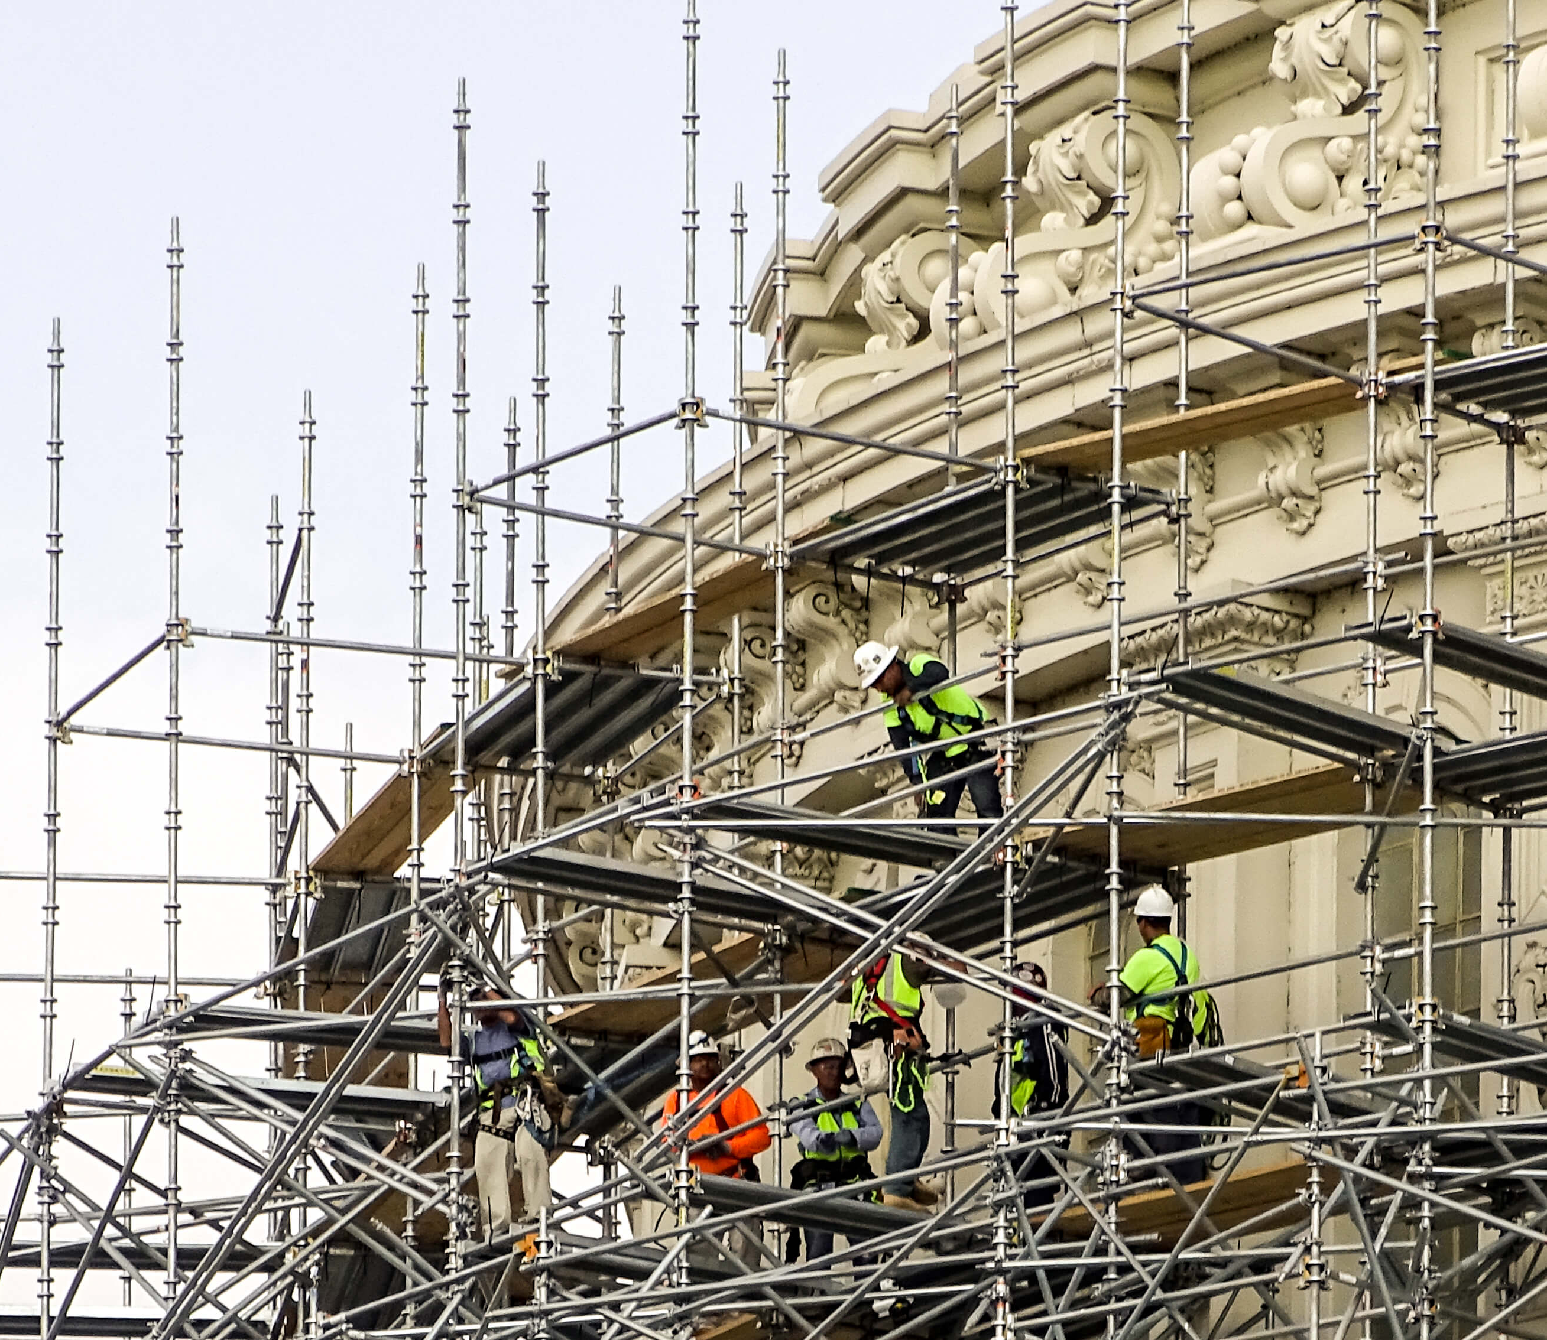
SP Support Key Points

Slide 22
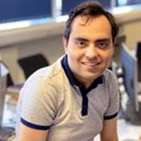
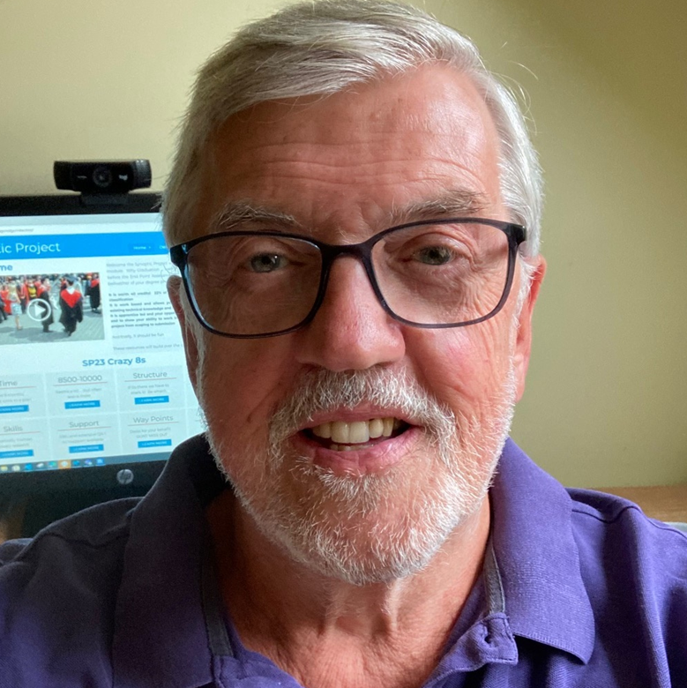
| ENU | QA | YOU! |
Dr Kia Dashtipour
Module Lead ENU
Arbiter / moderator
Coordinates SP
Manages Quality
John Colvin QA 1st point of contact
1st supervisor / marker
Advise on progress and refer and seek specialist advice if needed
Run Workshops+
Group / 1:1 tutorials
High or Low side

Slide 23
Your Support – short term: September – November 24
Apprentices in workplace by invitation and need
Discuss and identify potential project topic(s)
Assist apprentice to develop topic(s)
Agree / Reassure: Time | Space| Resources|
Enthusiasm

Slide 24
Line Manager Role: November 24 - April 25
Motivate
Advise – “SME”
Facilitate! – oversight and time
Inform/ feedback if concerned – CSF/ JC
Celebrate☺

Slide 25
Summary
September 23 – April 24
40 credits: c10,000 words
Support Team: ENU, QA, Line Managers
Self-managed individual project
Ideally work based
Developed and reported at Level 6/10
Time made available
Should be fun!

Slide 26
Questions?

