Slide 1
Introduction to quantitative research: data collection #5
John Colvin

Slide 2
A note about data
Quantitative data is about quantities, and therefore numbers
Qualitative data is about the nature of the thing investigated, and tends to be words rather than numbers
Difference between primary and secondary data sources
Be aware of research data management practices and archives of data sets (both in terms of downloading and uploading)
Notes:
The Role of the Researcher
The researcher can be either involved, or external, detached.
These two positions, again, tend to link to the ontology and epistemology, with the positivist approach leading to a detached view, and the social constructionists tending towards the researcher being part of the world and therefore influencing, and being influenced by, events.
Choices and Trade-Offs
The choice of any particular research design, from ontology, through epistemology to methodology and then methods and techniques, involves trade-offs.
All of the main research traditions have strengths and weaknesses.
The most important aspect of designing your research is what you want to find out. Whatever methods you use, together with their underpinning philosophy, must answer your chosen research questions.
Find more at: http://www.skillsyouneed.com/learn/research-methods.html#ixzz40KrH4t80

Slide 3
Quantitative approaches
Attempts to explain phenomena by collecting and analysing numerical data
Tells you if there is a “difference” but not necessarily why
Data collected are always numerical and analysed using statistical methods
Variables are controlled as much as possible (RCD as the gold standard) so we can eliminate interference and measure the effect of any change
Randomisation to reduce subjective bias
If there are no numbers involved, its not quantitative
Some types of research lend themselves better to quant approaches than others

Slide 4
Quantitative data
Data sources include
Surveys where there are a large number of respondents (esp where you have used a Likert scale)
Observations (counts of numbers and/or coding data into numbers)
Secondary data (government data; SATs scores etc)
Analysis techniques include hypothesis testing, correlations and cluster analysis

Slide 5
Analysing quant data
Always good to group and/or visualise the data initially → outliers/cleaning data
What average are you looking for? Mean, median or mode?
Spread of data:
skewness/distribution
range, variance and standard deviation
Notes:
When most people say average, they are talking about the mean. It has the advantage that it uses all the data values obtained and can be used for further statistical analysis. However, it can be skewed by ‘outliers’, values which are atypically large or small.
As a result, researchers sometimes use the median instead. This is the mid-point of all the data. The median is not skewed by extreme values, but it is harder to use for further statistical analysis.
The mode is the most common value in a data set. It cannot be used for further statistical analysis.
The values of mean, median and mode are not the same, which is why it is really important to be clear which ‘average’ you are talking about.
The range is the difference between the largest and smallest values. Researchers often quote the interquartile range, which is the range of the middle half of the data, from 25%, the lower quartile, up to 75%, the upper quartile, of the values (the median is the 50% value). To find the quartiles, use the same procedure as for the median, but take the quarter- and three-quarter-point instead of the mid-point.
The standard deviation measures the average spread around the mean, and therefore gives a sense of the ‘typical’ distance from the mean.
The variance is the square of the standard deviation. They are calculated by:
calculating the difference of each value from the mean;
squaring each one (to eliminate any difference between those above and below the mean);
summing the squared differences;
dividing by the number of items minus one.
This gives the variance.
To calculate the standard deviation, take the square root of the variance.
Find more at: http://www.skillsyouneed.com/num/simple-statistical-analysis.html#ixzz40Puk0Bhw

Slide 6
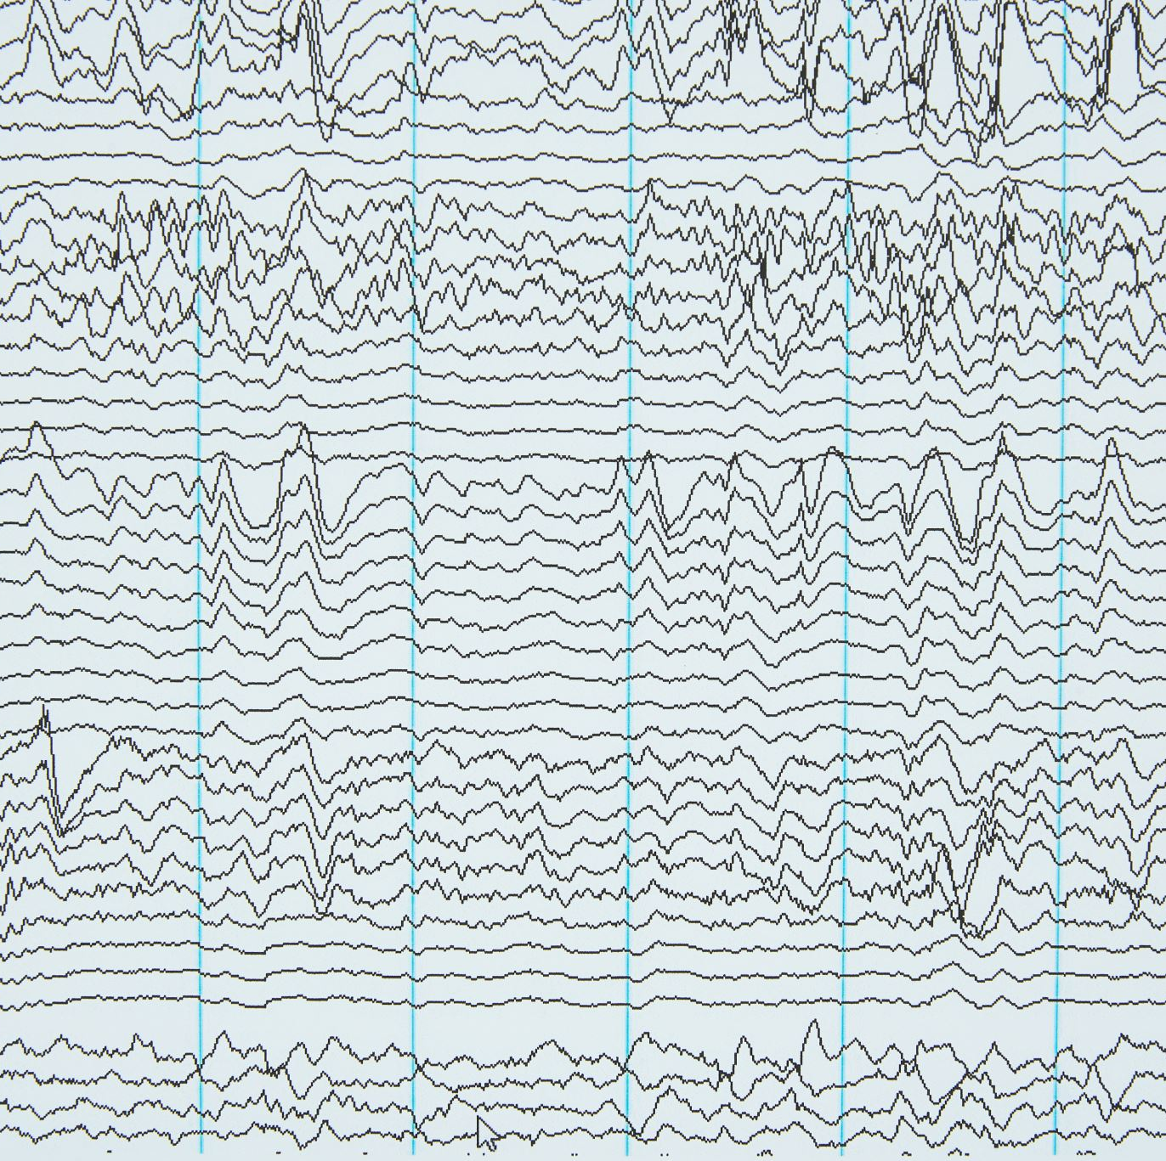
What are you looking for?
Trying to find the signal from the noise
Generally, either a difference (between/within groups) or a correlation
Choosing the right test to use: parametric vs non-parametric (depends what sort of data you have – interval/ratio vs nominal/ordinal and how it is distributed)
Correlation does not imply causation!
Notes:
If you get it wrong you risk using an incorrect statistical procedure or you may use a less powerful procedure.
Non-paramteric statistical procedures are less powerful because they use less information in their calulation. For example, a parametric correlation uses information about the mean and deviation from the mean while a non-parametric correlation will use only the ordinal position of pairs of scores.
The basic distinction for paramteric versus non-parametric is:
If your measurement scale is nominal or ordinal then you use non-parametric statistics
If you are using interval or ratio scales you use parametric statistics.
There are other considerations which have to be taken into account:
You have to look at the distribution of your data. If your data is supposed to take parametric stats you should check that the distributions are approximately normal.The best way to do this is to check the skew and Kurtosis measures from the frequency output from SPSS. For a relatively normal distribution:
skew ~= 1.0 kurtosis~=1.0
If a distribution deviates markedly from normality then you take the risk that the statistic will be inaccurate. The safest thing to do is to use an equivalent non-parametric statistic.
www.csse.monash.edu.au/~smarkham/resources/scaling.htm - Nominal, ordinal etc.

Slide 7
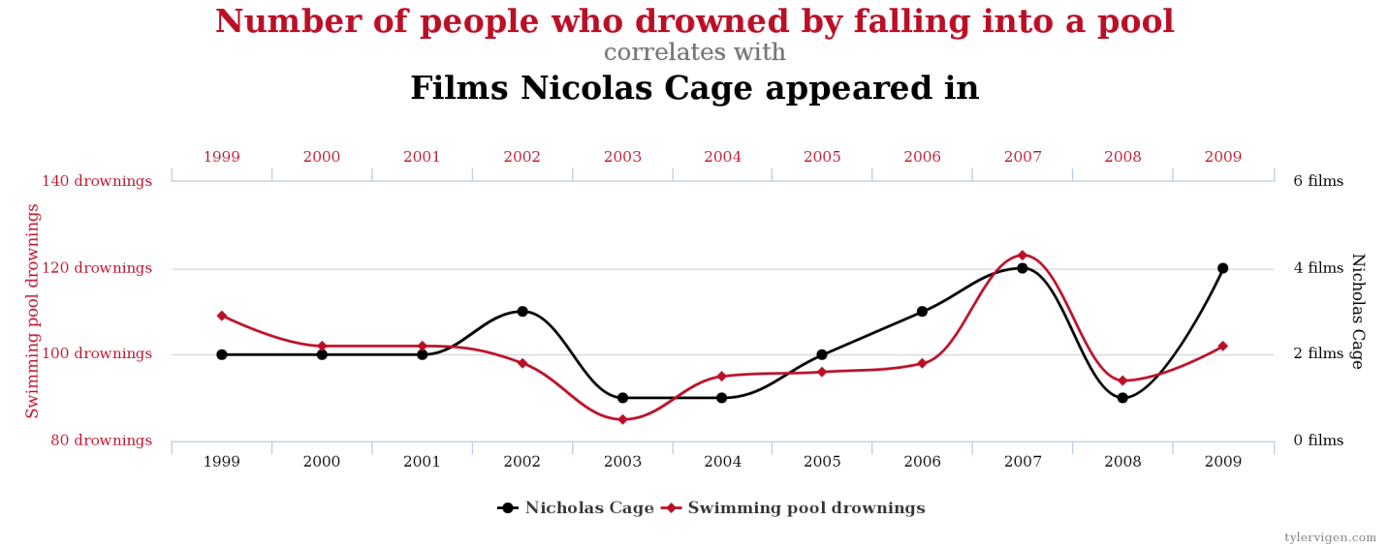
Example correlations
From ‘Spurious correlations’ website http://www.tylervigen.com/spurious-correlations

Slide 8
Interpreting test statistics
Significance level – a fixed probability of wrongly rejecting the null hypothesis H₀, if it is in fact true. Usually set to 0.05 (5%).
p value - probability of getting a value of the test statistic as extreme as or more extreme than that observed by chance alone, if the null hypothesis H₀, is true.
Power – ability to detect a difference if there is one
Effect size – numerical way of expressing the strength or magnitude of a reported relationship, be it causal or not
Notes:
Significance level of a statistical hypothesis test is a fixed probability of wrongly rejecting the null hypothesis H0, if it is in fact true.
The probability value (p-value) of a statistical hypothesis test is the probability of getting a value of the test statistic as extreme as or more extreme than that observed by chance alone, if the null hypothesis H0, is true.
Small p-values suggest that the null hypothesis is unlikely to be true. The smaller it is, the more convincing is the rejection of the null hypothesis. It indicates the strength of evidence for say, rejecting the null hypothesis H0, rather than simply concluding "Reject H0' or "Do not reject H0".
The power of a statistical hypothesis test measures the test's ability to reject the null hypothesis when it is actually false - that is, to make a correct decision. Ability to detect a difference.

Slide 9
Example of quant data/analysis*
Matched users were those who learning styles were matched with the lesson plan e.g. sequential users with a sequential lesson plan. Mismatched participants used a lesson plan that was not matched to their learning style, e.g. sequential users with a global lesson plan.
H₀ – there will be no statistically significant difference in knowledge gained between users from different experimental groups
H₁ – students who learn in a matched environment will learn significantly better than those who are in mismatched environment
H₂ – students who learn in a mismatched environment will learn significantly worse than those who learn in a matched environment
* Case study taken from: Brown, Elizabeth (2007) The use of learning styles in adaptive hypermedia. PhD thesis, University of Nottingham. http://eprints.nottingham.ac.uk/10577/

Slide 10
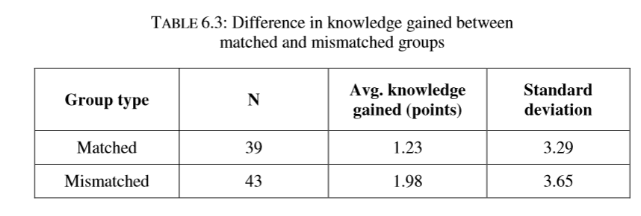
Interpreting test statistics
Statistical testing was carried out using a univariate ANOVA in SPSS, to determine if there was any significant difference in knowledge gained.
Initial conjecture suggests that the mismatched group actually performed better than the matched group.
However, the difference between the two groups was not significant (F(1,80)=0.939, p=0.34, partial eta squared = 0.012) and hence hypotheses 1 and 2 can be rejected.
Notes:
If the null hypothesis is true, you expect F to have a value close to 1.0 most of the time. A large F ratio means that the variation among group means is more than you'd expect to see by chance. You'll see a large F ratio both when the null hypothesis is wrong (the data are not sampled from populations with the same mean) and when random sampling happened to end up with large values in some groups and small values in others.
The P value is determined from the F ratio and the two values for degrees of freedom shown in the ANOVA table.
Degrees of freedom - http://ron.dotsch.org/degrees-of-freedom/
to describe the number of values in the final calculation of a statistic that are free to vary.
partial eta squared = measure of effect size. .02 ~ small
.13 ~ medium
.26 ~ large

Slide 11
What quant researchers worry about
Is my sample size big enough?
Have I used the correct statistical test?
have I reduced the likelihood of making Type I and/or Type II errors?
Are my results generalisable?
Are my results/methods/results reproducible?
Am I measuring things the right way?

Slide 12
Summary

