Slide 1
How To Design A Survey_Questionnaire_ Interview Technique #7
John Colvin

Slide 2
What is a Questionnaire?
A tool for collecting information to describe, compare, or explain an event or situation, as well as, knowledge, attitudes, behaviors, and/or sociodemographic characteristics on a particular target group.

Slide 3
Before the Design of Quetionnaire
Your approach should take consideration of:
Your topic
Who you want survey
The type of information you want
Your budget
How quickly you need the information

Slide 4
Questionnaire Design
Questionnaire design is a systematic process in which the researcher contemplates various question formats, considers a number of factors characterizing the survey at hand, ultimately words the various questions very carefully, and organizes the questionnaire’s layout.

Slide 6
Procedure for Development
Specify what information will be sought
Determine the type of questionnaire and method of administration
Determine the content of individual questions
Determine the form of response to each question
Determine the wording of each question

Slide 7
Types of Questions in a Questionnaire
Open questions
more information but difficult to codify, enter, and analyze
Closed questions
less information but easy to codify, enter, and analyze

Slide 8
Open-ended questions
Help collect qualitative data in a questionnaire where the respondent can answer in a free form with little to no restrictions.
What are your expectations/ requirements for this product (Information gathering)
What do you see as the next action steps? (Qualifying)
What’s the most important priority to you with this? Why? (Establishing rapport)

Slide 9
Close-ended questions
They are a multiple-choice questions type in which a respondent has to select one (single select multiple choice question) or many (multiselect multiple choice question) responses from a given list of options.
Have you been stressed lately?
Yes
No

Slide 10
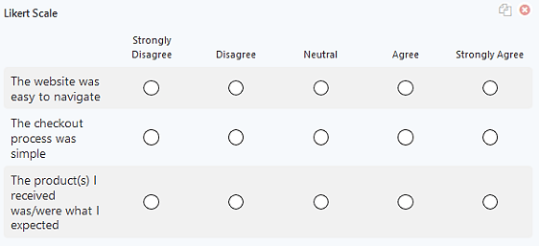
Types of Multiple Choice Questions
Likert Scale

Slide 11
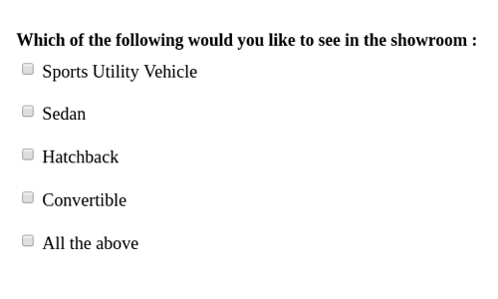
Types of Multiple Choice Questions
Checklist type

Slide 12
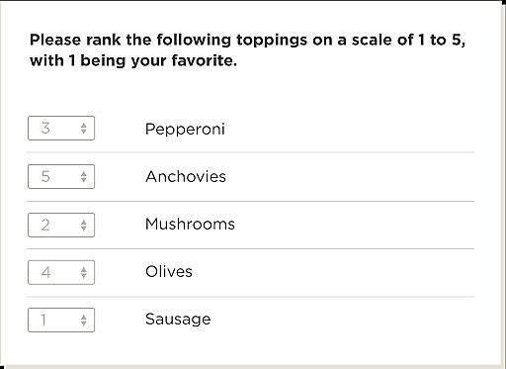
Types of Multiple Choice Questions
Rank Order

Slide 13
Types of Multiple Choice Questions
Rating Scale

Slide 14
Common mistakes
What was the first drink you had today?
Tea
Coffee
Water
Juice
Haven’t had a drink today
Other (please state)
What might be wrong with this question?
Need to cover all options
Notes:
What might be wrong with this closed question?
When writing closed questions ensure you cover all options or it could bias the analysis. – if unsure whether you have covered everything add an Other option to capture that data.
The answers from closed questions are easier to analyse BUT you are not leaving it open to allow respondents to raise unexpected, or missed, issues. OR to explain their answers.
Other tip for closed questions is :
Research has shown that in self completion questionnaires the first options on a list are chosen most often – whereas in interview situations the latter options are chosen most often.
Additional information
* There is evidence that openin

Slide 15
Common mistakes
What might be wrong with this question?
What is your age group?
0-18 | 18-30 | 30-45 | 45+
✗
0-18 | 19-30 | 31-45 | 46+
Options should be mutually exclusive.
✓
Notes:
Sometimes it can be better to appear pedantic than to risk skewing the responses.

Slide 16
Common mistakes
What might be wrong with this question?
What did you think about the waiting time?
Excellent | Very good | Good | Average | Poor
Options should be balanced
‘Good’ responses
‘Bad’ response
Notes:
You’re giving many more good options than poor ones – this is unbalanced.
Number of points used:
Recommend to use either five or seven point scales.
Generally, three-point scales are too narrow to be effective, and there is no evidence that nine points gives greater precision than a seven point scale.
Stick to using the same range of options for all questions where possible.
Or at least for each section
If necessary re-phrase your questions so that they work with the ratings.

Slide 17
Common mistakes
What might be wrong with this question?
How would you rate the appointment booking service using the:
 | Good | Average | Poor
Website
Phone
Reception
N/A
Use opt-out responses appropriately
Notes:
Consider whether an opt out is needed.
Don’t feel qualified
Never considered the subject before
Haven’t used
You need to ensure you are not forcing an answer when an opt out is appropriate. You need to weigh up the options of giving someone an easy way out of not answering a question and a genuine need for an opt out.
Are you asking the question to everyone who booked, will everyone have used all options.
This is fine IF everyone answering has used all of the booking systems, and you’ve chosen your sample on that basis. Respondents tend to try and be useful and answer all questions are even if they haven’t used a service so are likely to use a default response of ‘average’ as their equivalent of an opt out. When you come to analyse the results you will then have no real idea of who found the service ‘Average’ and those who did not actually use the service.
This isn't just for attitude questions it is for any question – even with NICE guidelines there are still often cases where exceptions are allowable. Feel free if you need to get them to justify WHY it’s not applicable – but don’t force, and therefore skew an answer.

Slide 18
Demographics
Need to know how opinions and behaviors vary across different categories of people
Such things as
Gender, age,
Income, education levels
Political beliefs
Put at end of instrument
Easy to answer

Slide 19
Types of questionnaire

Slide 20
Self-Completed
Respondents complete on their own
Best designed for
Measuring variables with numerous values or response categories
Investigating attitudes and opinions not usually observable
Describing characteristics of a large population
Studying ‘private’ or ‘difficult’ behaviors

Slide 21
Self-Completed – Disadvantages
Closed-ended items limit the researcher
Adjust for differences in respondents
Clarify misunderstood items
Explain ambiguity
Not suitable for all audiences
Young children
Visually impaired
Learning/reading disabilities

Slide 22
How To Obtain Valid Information
Ask purposeful questions
Ask concrete questions
Use time periods based on importance of the questions
Use conventional language
Use complete sentences
Use shorter questions

Slide 23
How To Obtain Valid Information
Avoid abbreviations
Avoid two-edged questions
Avoid negative questions
Adopt/adapt questions used successfully in other questionnaires

Slide 24
Words to Avoid in Questionnaire Development
These words: all, any, anybody, best, ever, every, never, etc. are all EXTREME ABSOLUTES…
They place respondents in a situation where they must either fully agree or they must completely disagree with the extreme position in the question.
Do you always observe traffic signs?
Would you say all cats have four legs?

Slide 25
Interviews
Reading questionnaire items in a face-to-face or telephone situation
Unstructured or in-depth
Suited for exploratory research
Either with one person or in focus groups
Open-ended items
Cannot standardize
Good for complex situations

Slide 26
Interviews
Response rates tend to be highest with face-to-face interviews
Issues
More time
Smaller samples
Higher cost

Slide 27
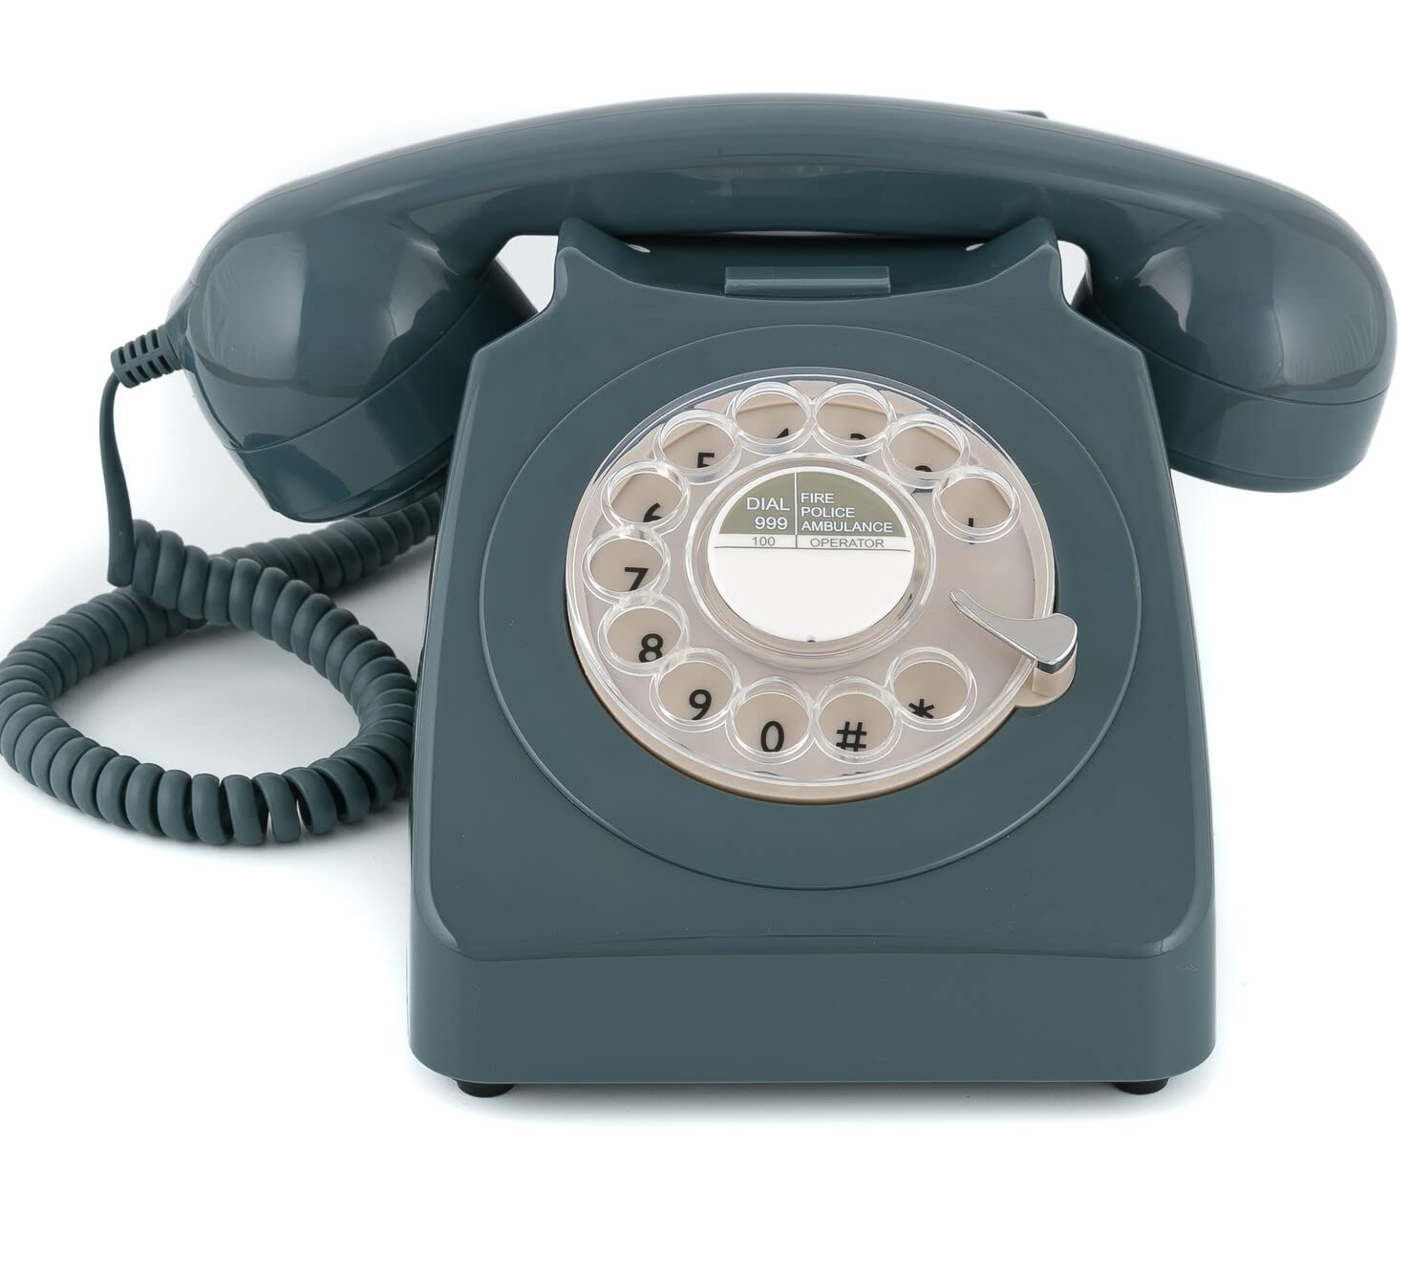
Telephone
Most popular
Less costly
Less time
Less subjective to interviewer
As compared to face-to-face
Often conducted with computers
Can probe for information/clarification
Threshold about 20 minutes

Slide 28
Constructions
Regardless of survey type, construct in a way
Allows for candid answers
Accurately
Consistently
Addresses goals, hypotheses, research questions

Slide 29
Instructions
Beginning of each section, should include clear instructions
Disclose needed information for respondents to decide whether to complete the survey
Tell whether
Anonymous: no names or IDs
Confidential: names or IDs, not attached responses

Slide 30
Instructions
Give information about questionnaire time
Be consistent with instructions and format
A little variation might break up ‘routine’
Avoid ambiguity, confusion, and vagueness.
Make sure it is absolutely clear what you are asking and how you want it answered.
Avoid indefinite words or response categories.

Slide 31
Instructions
Avoid asking questions beyond a respondent's capabilities
People have cognitive limitations, especially when it comes to memory of past events.
It is pointless to ask people about things that are not natural ways for them to think.

Slide 32
Case Study?
Questionnaire Design | Methods, Question Types & Examples - Scribbr
How to Design an Effective Questionnaire - iMotions
Questionnaire: Definition, How to Design, Types & Examples - Qualtrics XM
How to Make a Questionnaire: Examples + Template - SurveyKing
How to design a questionnaire for research - Enago
en.wikipedia.org

Slide 33
Summary

