Slide 1
Academic Poster

Slide 2
Why a Poster?
Posters are widely used in the academic community, and most conferences include poster presentations in their program.
Posters can summarize information or research concisely and attractively to help publicize it and generate discussion.
The poster is usually a mixture of a brief text mixed with tables, graphs, pictures, and other presentation formats.

Slide 3
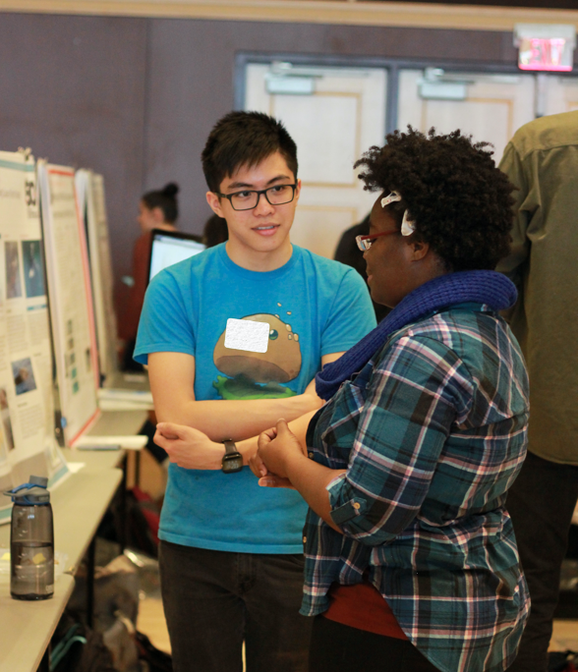
Your Poster?
An introduction to your 1st idea(s).
Not assessed: opportunity for Peer Formative Feedback
No risk

Slide 4
Plan your poster
What size can we go to?
What are your headings – as recommended?
How much text do you want to display?
Where do you want to place images to support your text?
Are you going to use charts or SmartArt … or freehand?
This Photo by Unknown Author is licensed under CC BY

Slide 5
How should your poster look?
Don’t have large amounts of text – be concise
If your text is too small, your audience won’t read it
Avoid complex graphics and charts
Don’t mix justified, centred and left aligned text
Use headings

Slide 6
Carefully consider colours and images…?
Avoid rainbow colours - always use solid colours and not more than two or three in the poster
Avoid clipart and cartoon images
Don’t place images (or in this case) letters behind text
Use clear headings
This Photo by Unknown Author is licensed under CC BY

Slide 7
What to include?
a title
a short introduction, / rationale
proto aim and objectives,
Literature overview (v brief)
1st thoughts on data acquisition ?
This Photo by Unknown Author is licensed under CC BY

Slide 8
Show process…?
Over to the Team
This Photo by Unknown Author is licensed under CC BY

Slide 9
Summary?
Title should be short, meaningful and draw interest
Important information should be readable from about 3 metres away
Text should be clear, brief and concise
Make use of bullets, numbering, and headings to help guide your audience
Use good quality and effective graphics, colours and fonts (no cartoons or clipart!)
Use a consistent and clean layout
Include your name, references according to Harvard Convention

Slide 10
More Resources

